Slide 1
Welcome to the Monthly KESA Updates and Support Meeting!
This session is scheduled to start promptly at 9:00 a.m. providing!
Notes:
This session is scheduled to start promptly at 9:00 a.m. providing!

Slide 2
Kansas Education System Accreditation (KESA) Update – December 14, 2021
Notes:
Welcome everyone to the KESA Update for February. I am glad to see and be able to visit with you today. (next slide)

Slide 3
Today’s Purpose
KESA Application reminders
General updates
Regional Training and Support Model
Requesting your feedback
Answer any of your questions

Slide 4
KESA Application
Notes:
Still accessed through the Authenticated Application

Slide 5
KESA Application: Things to know
Reports not lost
SAVE, SAVE, SAVE
All systems years two – five need to add their goals in Year One
1. Needs Assessment Process and Goals section
2. Click on “Add New Goal”
Does not mean it has to be a new goal; it just opens the section where your current goal is needed
3. Scroll to “State Your Measurable Goal”
Write your measurable goal (Not just goal area)
4. Save Goal
Repeat process for Goal 2
5. If you already show a Goal One and Goal Two, just click on the plus sign and do #3 and 4 only.
Notes:
Goals in Y
Current, Past, Archived
ear one before going to your current year in KESA. Only systems that just got accredited start the new forms with Year One on the KESA App.

Slide 6
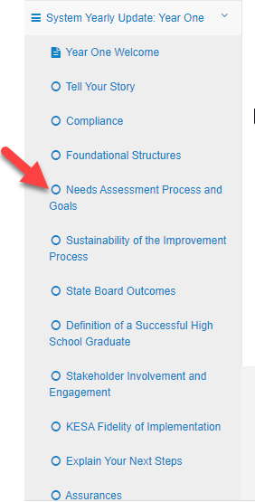
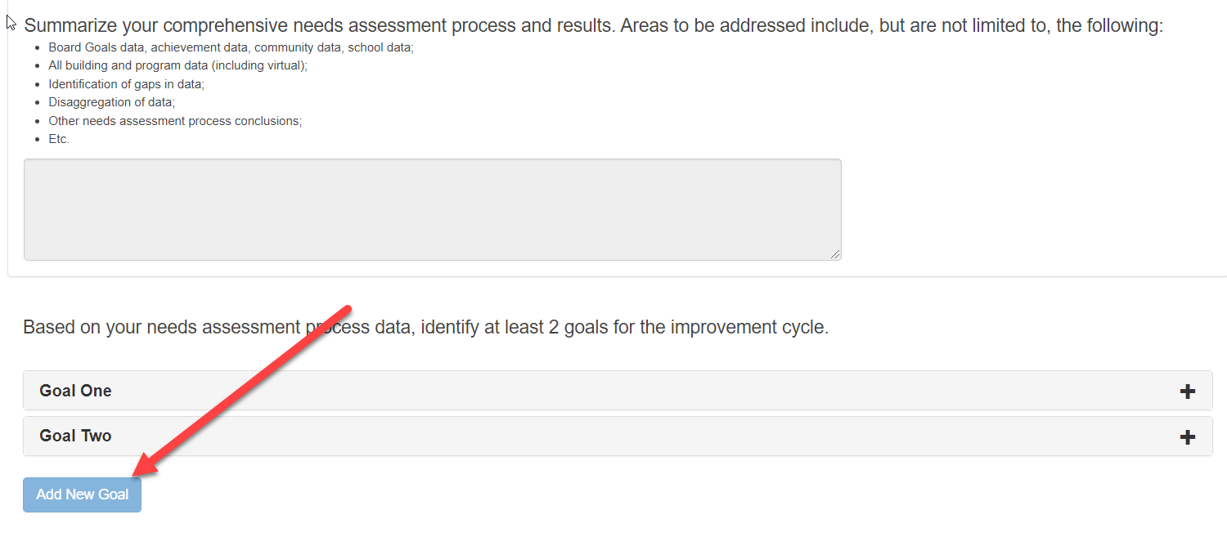
1.
2.

Slide 7
3.
4.
5.
Notes:
Perfect time to write measurable goals if you don’t have them written as such.

Slide 8
KESA Application: Things to know
Last year reports should have been uploaded in the Artifact section of the KESA Application
Artifacts found in System Response section
Compliance – Done by KSDE
Problem with October compliance
Be sure to relook at compliance in April
If a question does not need a response in that year, be sure to mark N/A as a response.
Save often
Notes:
If you paused, your pause survey should have been uploaded into the KESA Artifacts. If you did not pause, then your system Yearly Report for last year should have been uploaded into the KESA Artifacts section.

Slide 9
General Updates and Reminders
Next KESA Newsletter scheduled for January 2022 - https://www.ksde.org/Agency/Division-of-Learning-Services/Teacher-Licensure-and-Accreditation/KESA/KESA-Newsletters
Foundational Structure Rubrics - https://www.ksde.org/Agency/Division-of-Learning-Services/Teacher-Licensure-and-Accreditation/KESA/Resources/Foundational-Structures
OVT Online Training - https://learning.ksde.org/course/index.php?categoryid=40
Guidance Document
Notes:
Guidance Document
At our graphics department
January – February on line

Slide 10
General Updates and Reminders
Year 5 System and OVT Chair Training
Date | Time | ZOOM Link and Meeting ID
Thursday, December 16, 2021 | 9:00 – 11:00 | https://ksde.zoom.us/j/83389803846 Meeting ID: 833 8980 3846
Friday, December 17, 2021 | 9:00 – 11:00 | https://ksde.zoom.us/j/83389803846 Meeting ID: 833 8980 3846
Tuesday, December 21, 2021 | 1:00 – 3:00 | https://ksde.zoom.us/j/86167198220 Meeting ID: 861 6719 8220

Slide 11
Regional Training and Support Model
Purposeful Support for systems in the beginning of their accreditation cycle (Year One)
Training around continuous improvement phases
Data Analysis
Set Goals
Strategy Selection
Strategy Implementation
Strategy Analysis
Notes:
KESA as an accreditation process is not changing, at this time. What is changing is the vernacular used around the continuous improvement process

Slide 12
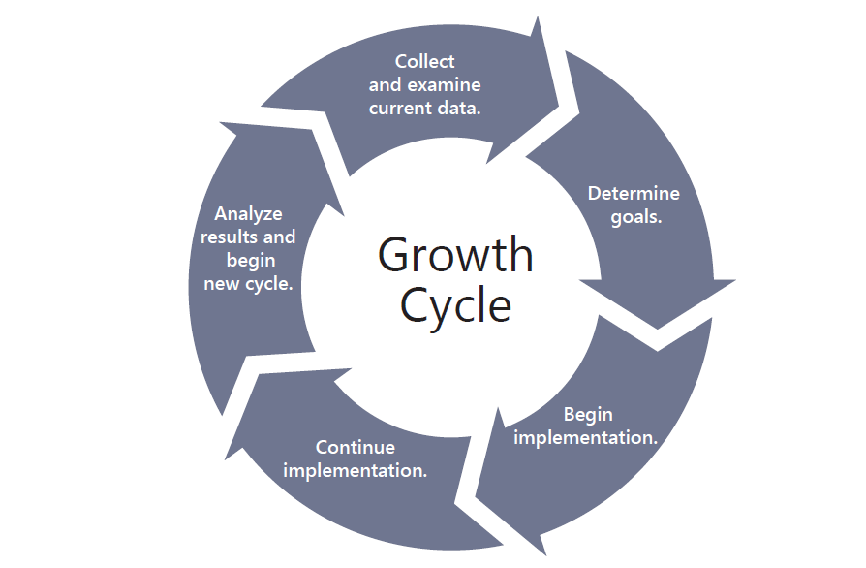
Data Analysis
Strategy Analysis
Set Goals
Strategy Implementation
Strategy Selection

Slide 13
Data
Analysis
Set Goals
Strategy Selection
Strategy Analysis
Strategy Implementation

Slide 14
Data Analysis | Set Goals | Strategy Selection | Strategy Implementation | Strategy Analysis
-Identify and analyze data sources, both qualitative & quantitative -Prioritize and compare data: perception vs. reality -Analyze prioritized data points | -Clarify core values and vision -Set and align goals with data -Move State Board Outcomes & Definition of Successful High School Graduate -Involve and engage family, community, and business | -Select measurable strategies -Select evidence-based strategies -Strategies support your goals | -Create an implementation plan -Support with professional development -Execute and sustain with fidelity | -Evaluate -Monitor -Adjust
Notes:
These are the main concepts being trained on. Data Analysis is completed and Setting Goals is next to be rolled out. At this time this is only a one day training.
Expectations for those involved in the training are the same, except for the requirement of an onsite visiting team. Because they are participating in in-depth training with KSDE, it was felt that an OVT visit would not be necessary.
Training for other sections are in development

Slide 15
Regional Support Model Concept Feedback (Menti Code: 63 75 34 2)
During the next two years KSDE hopes to fully implement a regional support and training model on continuous improvement across the state.
Should all systems be required to attend?
If the Regional Support and Training Model is only provided to those that need it, what are your thoughts on how that should be determined?
If all systems should participate, what are your thoughts regarding a system support and training tiered approach with criteria for each level?

Slide 16
Accreditation Definitions
“Accredited” means the system is in good standing (compliance) with the State Board, and that they have provided conclusive evidence of growth in student performance. In addition, the system has provided conclusive evidence of an intentional, quality growth process.

Slide 17
Accreditation Definitions
“Conditionally Accredited” means the system is in good standing (compliance) with the State Board, and either the system did not provide conclusive evidence of growth in student performance or was not able to provide conclusive evidence of an intentional, quality growth process.

Slide 18
Accreditation Definitions
“Not Accredited” means one of two things:
The system is not in good standing (compliance) with the State Board; or
The system did not provide conclusive evidence of growth in student performance, and the system was not able to provide conclusive evidence of an intentional, quality growth process.

Slide 19
Feedback on First KESA Cycle (Menti Code: 1887 2575)
What is one or two words you would use to describe accreditation?
What parts of KESA works well?
What parts of KESA have not worked well?

Slide 20
Questions?

Slide 21
2021-2022 Monthly KESA Updates
Tuesday, October 12, 2021
Tuesday, November 9, 2021
Tuesday, December 14, 2021
Tuesday, January 11, 2022
Tuesday, February 8, 2022
Tuesday, March 8, 2022
All KESA monthly updates are done via Zoom and recorded. They are scheduled from 9:00 – 10:00 a.m. on the dates listed above.
Registration: https://ksde.zoom.us/meeting/register/tZMpfu6prDgqG9NdArF0ovR2otXJyBq0U_Oe
Notes:
Please mark your calendars for next year’s KESA Updates. A reminder with the dates, time and zoom link for registration will be sent out in August.

Slide 22
Thank You!

Slide 23
Dr. Mischel D. Miller Director Teacher Licensure and Accreditation (785) 296-8010 mmiller@ksde.org
Jeannette Nobo
Assistant Director- KESA Teacher Licensure and Accreditation (785) 296-4948 jnobo@ksde.org
Myron Melton
KESA Coordinator
Teacher Licensure and Accreditation
(785) 296-8110
mmelton@ksde.org
John Girodat
Education Program Consultant - KESA
Teacher Licensure and Accreditation
(785) 368-7356
jgirodat@ksde.org
Ed Kalas, Education Program consultant
Professional Learning and Mentoring
Teacher Licensure and Accreditation
(785) 296-2198
ekalas@ksde.org

